Slide 1

ASTANA IT UNIVERSITY | 2026
Development of a Method for
Protecting Mobile Payment Systems
from Relay and Skimming Attacks
NFC Security • Android HCE • Machine Learning • HMAC-SHA-256
Student: Zhumagazy Abylay
Group: CS-2304
Supervisor: PhD Amirova Akzhibek
Programme: 6B06301 — Cybersecurity

Slide 2
Motivation & Problem Statement
Why protecting NFC mobile payments matters
THE PROBLEM
GAP IN EXISTING DEFENCES
$10T+
Global contactless payment volume in 2023
✗ Classical EMV: no distance-bounding, relay-transparent
Rising
NFC adoption in Kazakhstan (Kaspi, HalykBank, etc.)
✗ Distance-bounding: requires UWB hardware, not commodity
✗ Ambient sensors: insufficient alone (adversarially defeated)
Broken
Security assumption: proximity ≠ authorisation
✗ ML detectors: mostly cloud-based, single-attack-type focus
2 threats
Relay attacks & skimming attacks exploit this gap
✗ No published prototype combines sensor + crypto + ML in one Android HCE app
Zhumagazy Abylay | CS-2304 | Astana IT University | June 2026

Slide 3
Research Objectives & Tasks
What this diploma project set out to achieve
Objective: Design, implement, and validate a multi-layer defence architecture that independently blocks relay and skimming attacks on Android NFC payment systems.
1
Literature Survey
4
ML Model
Survey & classify 32 existing countermeasures against relay and skimming attacks on NFC.
Train a TensorFlow Lite MLP classifier on a synthetic 500-sample NFC transaction dataset.
2
Architecture Design
5
Experimental Validation
Design HMFPV: a 3-level defence stack (sensor + crypto + ML) with fail-closed logic.
Validate against normal, relay, and skimming scenarios on Xiaomi Redmi Note 11 devices.
3
Android Prototype
Implement in Kotlin: HCE card emulator (SecurePaymentService) + POS terminal (MainActivity).
Zhumagazy Abylay | CS-2304 | Astana IT University | June 2026

Slide 4
HMFPV Framework — Architecture Overview
Hardware-ML-Freshness-Proximity-Verification: three independent defence layers
HMFPV Framework — Fail-Closed Defence-in-Depth Stack
L1
Physical Accelerometer Gate
Blocks SKIMMING
Checks linear accelerometer: if phone hasn't moved >0.5 m/s² in last 2000 ms → return 0x6A80 (no token generated)
Signal: ΔtMove > 2000 ms
L2
HMAC-SHA-256 Dynamic Token
Blocks REPLAY / SLOW RELAY
Android Keystore generates time-stamped HMAC-SHA-256 token per transaction. Key never leaves TEE. Tokens expire after 5000 ms.
Signal: Token age > 5000 ms
L3
On-Device MLP Anomaly Classifier
Blocks FAST RELAY
TFLite MLP (16→8→3) classifies transaction using RTT + timeSinceMove. 100% accuracy on test set. <1 ms inference, no cloud needed.
Signal: RTT > 80 ms → Class 1
Total processing overhead: ~7 ms | No cloud dependency | Works offline | Commodity Android hardware
Zhumagazy Abylay | CS-2304 | Astana IT University | June 2026

Slide 5
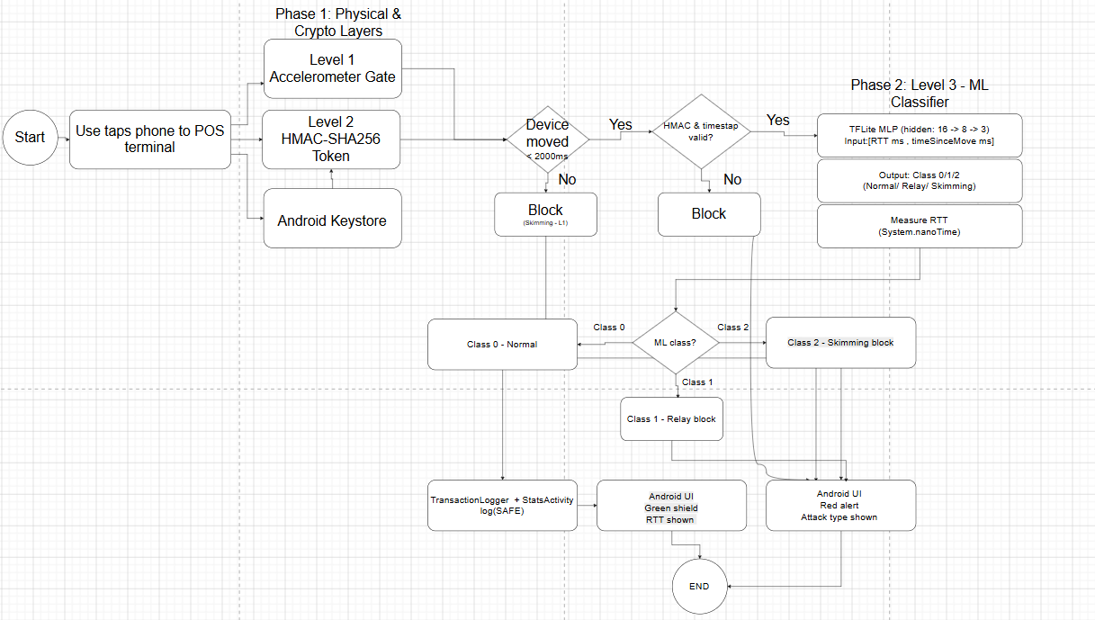
System Architecture

Slide 6
Methodology — Implementation Details
Three independent security layers integrated into Android HCE
Level 1 — Accelerometer Gate
Level 2 — HMAC-SHA-256 Token
Threshold: a = √(ax²+ay²+az²) > 0.5 m/s² → record lastMovementTime Gate: Δtmove > 2000 ms → return 0x6A80 (no token, no crypto leak) Bug fixed: init set to 0L (was currentTimeMillis → bypassed gate)
Key: Android Keystore (hardware-backed TEE). Never exported. Token: payload = "PAYMENT_OK_" ∥ tnow → HMAC-SHA-256[0:16] Check: Constant-time comparison + timestamp age ≤ 5000 ms
Level 3 — Dataset Engineering
Level 3 — MLP Classifier
Normal (0) (n=185)
RTT ~ N(20,8²) [5-80ms] | tsm ~ U(50-1000ms)
Architecture: Input(2) → Dense(16,ReLU) → Dense(8,ReLU) → Softmax(3) Training: Adam lr=0.001, 100 epochs, 20% validation split Result: 100% accuracy — confusion matrix: 0 misclassifications Deployment: .tflite → on-device inference <1 ms (no cloud)
Relay (1) (n=155)
RTT ~ N(250,80²) [80-600ms] | tsm ~ U(100-3000ms)
Skim (2) (n=160)
RTT ~ N(20,8²) [5-80ms] | tsm ~ U(2000-5000ms)
Technology Stack:
Kotlin 1.9 • Android API 34 • Android Keystore (HW) • TensorFlow Lite 2.17 • TFLite MLP (.tflite) • Python / scikit-learn • NFC ISO-DEP 106kbps
Zhumagazy Abylay | CS-2304 | Astana IT University | June 2026

Slide 7
Experimental Results
Tests on Xiaomi Redmi Note 11 — 10 transactions per scenario
MLP Confusion Matrix (Test Set, n=135)
Scenario Test Results (10 transactions each)
 | Pred Normal | Pred Relay | Pred Skim
Actual Normal | 55 | 0 | 0
Actual Relay | 0 | 37 | 0
Actual Skim | 0 | 0 | 43
Normal Payment
10/10 SAFE | Blocked by: None
RTT: 14–38 ms (mean 22 ms)
Relay Attack
10/10 BLOCKED | Blocked by: L2 (7) + L3 (3)
RTT: 195–430 ms (mean 312 ms)
Per-Layer Performance Overhead
Edge-Case Testing
Skimming
Operation | Mean (ms) | Max (ms)
NFC ISO-DEP baseline | 22 | 38
L1: Accelerometer check | <1 | <1
L2: HMAC sign (Keystore) | 3 | 8
L2: HMAC verify (Keystore) | 3 | 7
L3: TFLite MLP inference | <1 | 1
Total transaction latency | 29 | 55
10/10 BLOCKED | Blocked by: L1 (all 10)
Running motion skimming (10 trials)
RTT: 0x6A80 returned
→ 10 SAFE — no false positives
RF-noisy environment (10 trials)
→ 10 SAFE — RTT max 61 ms < threshold 80 ms
Rapid token replay <5s (5 trials)
→ 5 BLOCKED at L2/L3 — RTT anomaly detected
Zhumagazy Abylay | CS-2304 | Astana IT University | June 2026

Slide 8
Scientific Novelty & Comparative Analysis
HMFPV vs. existing solutions across six criteria
Solution | Relay Detect. | Skimming Prot. | ML Classifier | HW Keystore | HCE Compat. | No Spec. HW
EMV 3DS | Partial | No | No | Yes | No | Yes
Distance-Bound. | Yes | No | No | No | No | Yes
Ambient Sensor | Yes | Partial | No | No | No | Yes
PURE / UWB | Yes | No | No | No | No | No
ML Fraud Det. | Yes | No | Yes | No | No | Yes
HMFPV (this work) | Yes | Yes | Yes | Yes | Yes | Yes
Key Contributions (Novelty)
1
Only published architecture combining accelerometer gate + hardware Keystore cryptography + on-device ML in a single Android HCE app requiring no specialised hardware.
2
Critical bug fix: lastMovementTime init to 0L prevents the first 2 s bypass — documented as cautionary example of how security invariants can be broken by initialisation errors.
3
Fully functional Kotlin prototype (POS terminal + HCE card) validated experimentally: 0 false negatives, 0 false positives, ~7 ms overhead.
Zhumagazy Abylay | CS-2304 | Astana IT University | June 2026

Slide 9
Limitations & Future Work
Honest assessment and planned improvements
LIMITATIONS
Synthetic training data
FUTURE WORK
1. Collect real relay attack RTT traces for model fine-tuning
MLP trained on generated dataset. Field-collected labelled relay traffic would improve real-world generalisation.
2-feature ML model
2. Extend feature vector with ambient sensor channels (Markantonakis et al. 2024)
Only RTT + timeSinceMove. Adding NFC RSSI, Wi-Fi scan delta, gyroscope could reduce edge-case sensitivity.
HMAC truncation (64-bit)
3. Evaluate on wider device fleet — Keystore hardware availability survey
Token MAC truncated to fit NFC packet. Extending to 128-bit would strengthen forgery resistance for longer windows.
HW Keystore availability
4. Integrate UWB-based ranging on supported devices (optional Level 4)
Some Android devices fall back to software Keystore. HMFPV should detect and warn the user.
Gesture spoofing
5. Streaming-mode deployment via background service
Physical shake by attacker bypasses L1. Screen-unlock + accelerometer combination would close this vector.
Zhumagazy Abylay | CS-2304 | Astana IT University | June 2026

Slide 10
Conclusion
HMFPV Architecture
Zero False Negatives
Three independent layers (L1 Sensor + L2 HMAC + L3 MLP) block relay and skimming attacks at hardware, cryptographic, and inference levels simultaneously.
All 10 relay attacks and all 10 skimming attempts blocked in controlled experiments. Zero false positives on legitimate transactions.
Practical Overhead
Research Gap Closed
Only ~7 ms added latency per transaction on commodity Android hardware. No cloud dependency, fully offline.
First prototype satisfying all 6 criteria simultaneously: relay detection, skimming protection, ML, hardware Keystore, HCE, no special hardware.
THANK YOU FOR YOUR ATTENTION
Questions? | Zhumagazy Abylay | CS-2304 | Supervisor: PhD Amirova Akzhibek

